Slide 1











CHARACTERIZING INFECTION RISK IN A RESTAURANT ENVIRONMENT DUE TO AIRBORNE DISEASES USING DISCRETE DROPLET DISPERSION SIMULATIONS
HOW INFECTIOUS AGENTS CAUSE DISEASES

Slide 2







Airborne diseases
Airborne diseases are illnesses caused by pathogens (viruses, bacteria, or fungi) that can be transmitted through the air. These pathogens are carried in tiny droplets expelled when an infected person coughs, sneezes, talks, or breathes. Examples include COVID-19, tuberculosis, and the flu. People can become infected by inhaling these droplets, especially in poorly ventilated spaces.

Slide 3

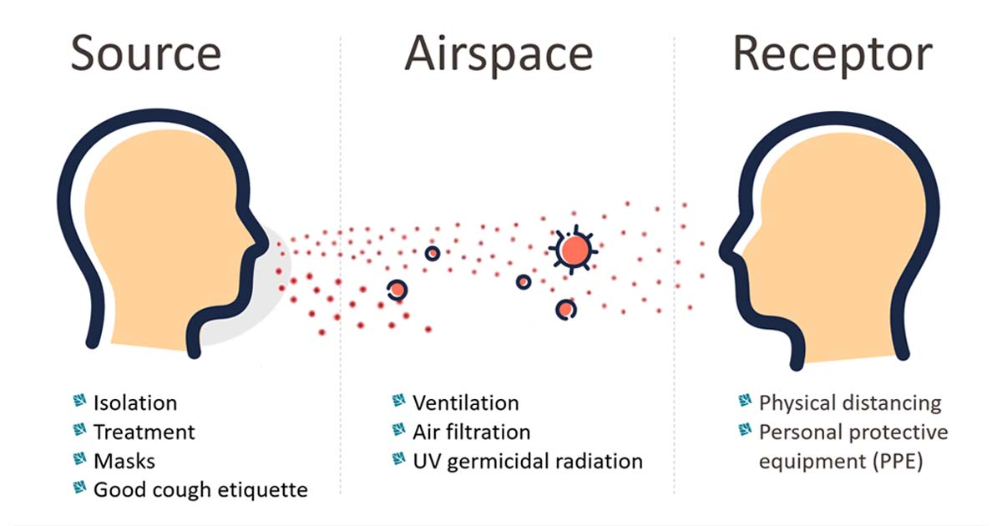

MAIN FEATURES
DROPLET DISPERSION SIMULATIONS:
Droplet dispersion simulations are computational models used to predict how respiratory droplets, which carry viruses or bacteria, spread in the air after being expelled from a person’s mouth or nose. These simulations take into account various factors like airflow, ventilation, and room layout to understand how far droplets travel and the risk of exposure for others in the space.

Slide 4




PROBABILITY OF INFECTION:
This refers to the likelihood or risk of a person becoming infected with a disease after being exposed to an infectious source. In airborne disease contexts, the probability of infection depends on factors like the concentration of viral particles in the air, ventilation quality, physical distancing, and the effectiveness of protective measures like masks or air filtration.

Slide 5
INTRODUCTION
CHALLENGES IN CONTROLLING AIRBORNE TRANSMISSION
Airborne transmission of diseases through virus-containing droplets poses a serious public health threat.
Examples include SARS, H1N1 influenza, and the COVID-19 pandemic, which caused global disruption and economic loss.
COVID-19 spread rapidly due to airborne transmission, in addition to person-to-person.
Direct transmission (person-to-person ) can be controlled with masks and hygiene.
Airborne transmission is more difficult to prevent, requiring specific risk avoidance strategies, particularly in indoor spaces.

Slide 6



PREVIOUS STUDY
GAP IN RESEARCH
Research Aim
Studies have examined indoor ventilation and airborne particle transmission in large rooms, medical centers, supermarkets, and transportation (airplanes, buses, trains).
Focused on how respiratory droplets move and disperse in indoor environments after expiratory events.
Few studies have focused on probability of infection risk when multiple sources of infection are present in an indoor setting.
No thorough characterization of infection risk with multiple infection sources in a given setup.
Quantifying risk in environments with several infection sources can provide more accurate and generalizable data.
Assessing infection risk in environments like restaurants, bars, and performance venues is crucial, where mask use is impractical.
Develop a methodology to assess infection risk in environments with multiple sources of infection using numerical simulations.
Focus on restaurant settings where mask use is not feasible for prolonged periods.

Slide 7
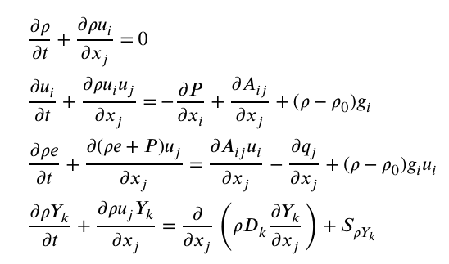



METHODS
2.1 governing equations
This study models how tiny droplets
, move through the air using a
Navier-Stokes solver. It combines
two methods: Eulerian to describe
how the air moves and Lagrangian
to track the motion of individual
droplets. The main equations solved are for the conservation of mass, momentum, energy, and species. These equations ensure that the air and droplets are behaving according to physics. The key variables are density (𝜌), velocity (𝑢ᵢ), pressure (P), and energy (e).

Slide 8
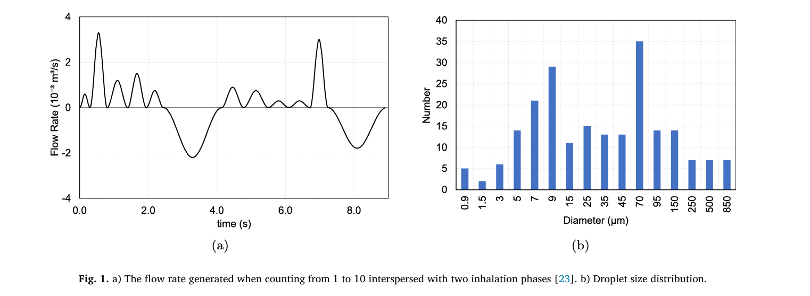
METHODS
2.2 DROPLET MODEL
The model tracks tiny liquid droplets, like sputum, as they move through the air. The droplets interact with airflow in a way that considers both their effects and the effects of the air on them. Their movement is influenced by drag and gravity, and they change size as they evaporate based on the surrounding conditions.
When droplets hit a surface, whether they stick or bounce off depends on something called the Weber number. If this number is low enough, the droplet sticks; if it's high, the droplet bounces back because of its speed. This model effectively shows how droplets move, evaporate, and interact with surfaces.

Slide 9
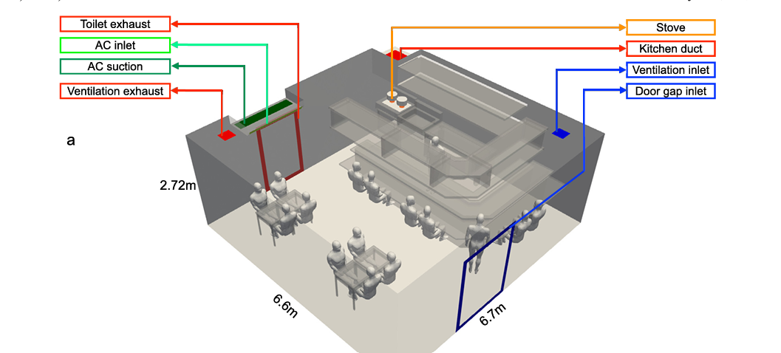
METHODS
2.3 SPEAKING AND DROPLET MODEL
The model for droplet dispersion during speech relies on three main factors:
The size and number of droplets released while speaking.
The exhalation rate over time.
The size of the mouth opening.
The speaking flow is based on
measurements of counting from
1 to 10, modeled as a sinusoidal
wave. We added inhalation
phases to balance the airflow
during speech. For loud speaking,
we increased the
flow rate by 50%. The mouth opening is modeled as a circular area of 6 cm², with droplets injected based on the timing of peak airflow during speech.

Slide 10
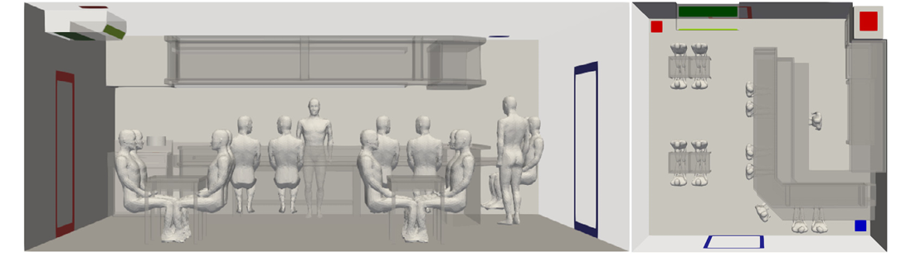
METHODS
2.4 RESTAURANT SETUP
The model represents a typical medium-sized Japanese izakaya restaurant with an open kitchen and seating for 16 people—two tables for four and an L-shaped kitchen counter for six, plus one standing cook. The room measures 6.7 × 6.6 × 2.3 meters.
Customers at the tables face each other,
while those at the counter talk to
neighbors on either side. The standing
staff and a customer also face forward
while speaking.
The restaurant's air circulation system
includes fresh air ventilation, air
conditioning, and kitchen exhaust. Fresh
air enters through a ceiling vent, while most stale air is removed through the ventilation exhaust, with additional air removed via the toilet exhaust. The AC unit cools the air, and the kitchen duct removes hot air when cooking. Overall, the setup aims to balance air supply and removal effectively.

Slide 11
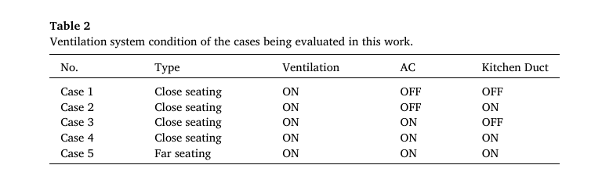
METHODS
2.4.1 CASES
The air circulation in the restaurant depends on the use of three systems:
Ventilation.
Air conditioning (AC).
Kitchen exhaust.
When the kitchen exhaust is off, the air exchange rate drops from 12.8 to 4.5 times per hour, and the AC does not affect this rate.
Five different cases are created
for this study based on how
these factors—like air circulation,
partitions, and distances—affect
air mixing and dispersion. Details
of each case are provided in this
table.

Slide 12
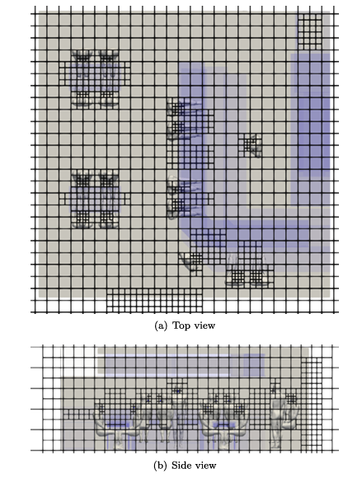
METHODS
2.5 SIMULATION CONDITIONS
The simulations use a tool called CUBE, which
divides the space into cubic blocks for detailed
airflow modeling. The mesh is finer near the mouth
(4.27 mm) and coarser further away (17.08 mm).
The model assumes a skin temperature of 300 K
and sets initial conditions to standard room levels:
297 K, 101.3 kPa pressure, and 60% humidity. The
mouth is modeled as a circular shape, and air from
it is at 95% humidity.
Droplets from speaking are injected into the
simulation with a temperature of 308 K and a
density of 1000 kg/m³. The setup runs for 100
seconds to establish airflow before simulating
speaking for another 100 seconds.

Slide 13
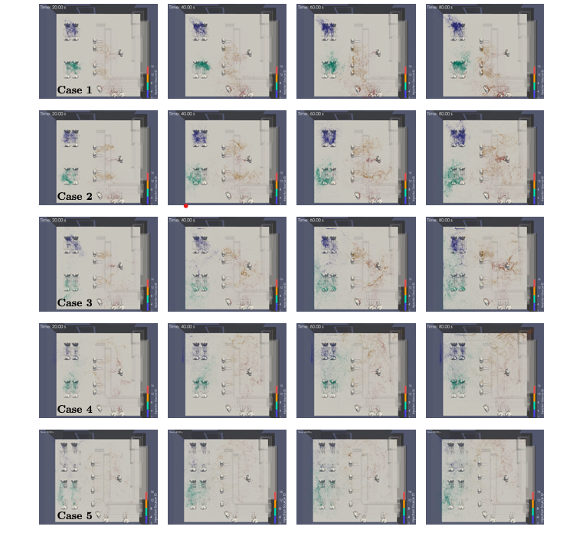
result
Validation & Droplet Dispersion
Validation: The droplet evaporation model was validated by comparing simulations with experimental data, showing strong alignment under specific conditions (1050 μm droplet, 0% humidity, 298 K temperature). The flow solver has been validated in prior studies for fluid dynamics.
Droplet Dispersion: Simulations in a restaurant
showed that ventilation alone caused mild
droplet spread, but when air conditioning (AC)
and kitchen ducts were added, dispersion
increased significantly. Full air circulation
caused the most droplet dispersion, especially
with subjects seated farther apart.

Slide 14
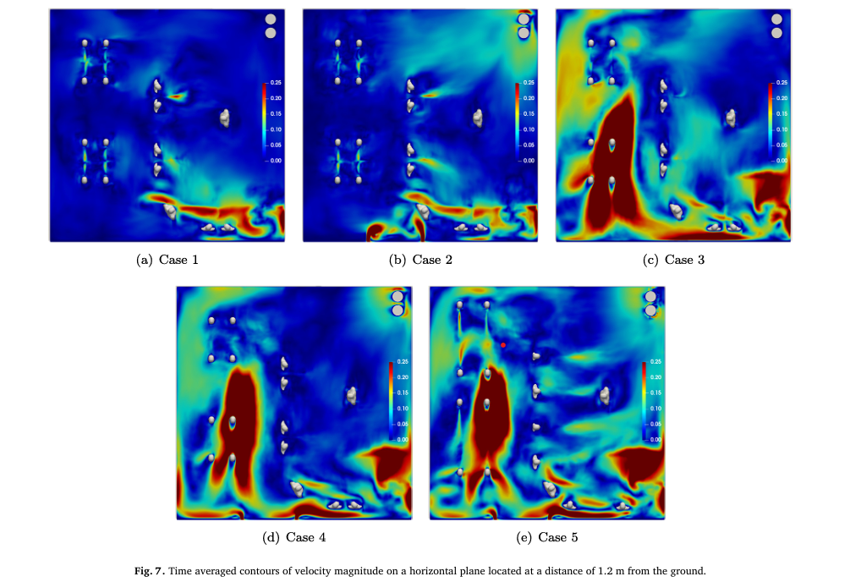
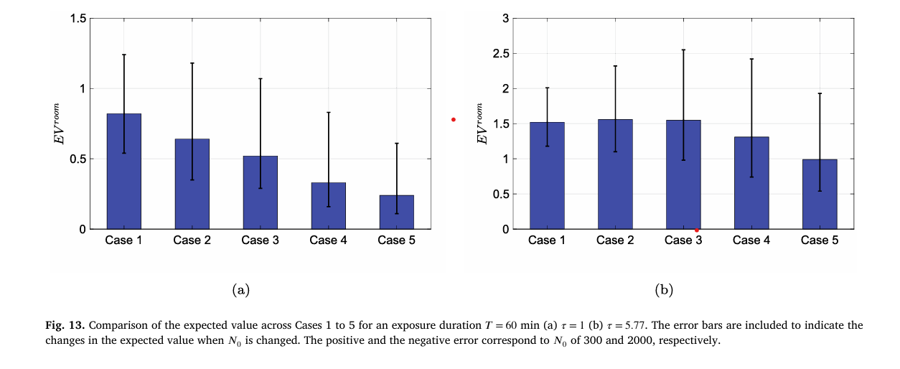
result
Infection Risk & Room Average Risk
Infection Risk: A dose-response model calculates
infection risk based on factors like exposure duration,
viral load, and subject location. The model tracks
inhalation zones to estimate person-to-person transmission
risk, using SARS-CoV-2 parameters.
Room Average Risk: The average infection risk
(P(avg)) for a room is determined by considering
various scenarios with different infected subjects
Factors like ventilation, distancing, and virus
transmissibility significantly impact both the overall infection risk and expected number of infections.

Slide 15
discussion
This study presents a statistical model to assess infection risk in indoor settings, particularly where multiple infection sources are plausible, such as restaurants. The model, based on droplet dispersion, considers factors like ventilation and exposure duration, showing high infection probabilities under certain conditions. While the results highlight the need for strict preventive measures, they are based on simplified assumptions, such as simultaneous speaking, which may overestimate droplet dispersion.

Slide 16
summary
This study investigates the transmission of respiratory infections in a restaurant setting through numerical simulations of droplet transport under various ventilation scenarios. Findings indicate that ventilation systems significantly impact droplet dispersion and infection risk. In cases with limited ventilation, droplet dispersion was confined, while enhanced ventilation led to greater dispersion and increased potential for contamination. A risk-mapping methodology was developed using the Wells-Riley infection risk model, revealing that mechanical mixing of air generally increases person-to-person infection risk. However, higher droplet dispersion does not always correlate with lower average infection risk, as this is heavily influenced by pathogen transmissibility. Low transmissibility benefits from mechanical mixing, while high transmissibility can negate its advantages, emphasizing the complexity of infection risk in indoor environments.

Slide 17









THANK YOU EVERYONE

